Slide 1
Final Project JCDS07 Job Recommendation at Google
Farid Rahman

Slide 2
Project Goals
This project’s aim is to help the candidate find a job based on their skills and experience. So it is easier for them to become a shortlist-ed candidate
To help the company to recruit candidates easier.
Improve time and cost efficiency

Slide 3
Project Description
Gather data
Analyze and Clean Data
Train model and compare the performance
Get the best model to predict the suitable job category
Get the keyword and use content-based filtering to get the best job title
Create the apps

Slide 4
Data Description
Source:
Title: The title of the job
Category: Category of the job
Location: Location of the job
Responsibilities: Responsibilities for the job
Minimum Qualifications: Minimum Qualifications for the job
Preferred Qualifications: Preferred Qualifications for the job
Columns:
Kaggle (Google Job Skills)

Slide 5


Data Manipulation
Minimum_Qualifications: same as “Minimum Qualifications” in dataset
Preferred_Qualifications: same as “Preferred Qualifications” in dataset
Minimum_Qualification_clean: remove stop word and punctuation from “Minimum Qualifications” column
Preferred_Qualifications_clean: remove stop word and punctuation from “Preferred Qualifications” columns
Qualifications: join column from “Minimum_Qualifications_clean” and “Preferred_Qualificatioins_clean” column
Qualifications_unique: remove duplicate word from Qualifications column
Qualification_stem: remove stemming from Qualifications_unique

Slide 6
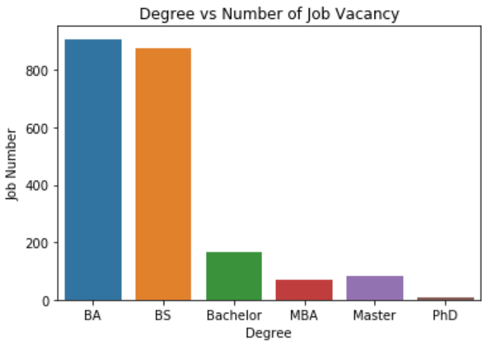
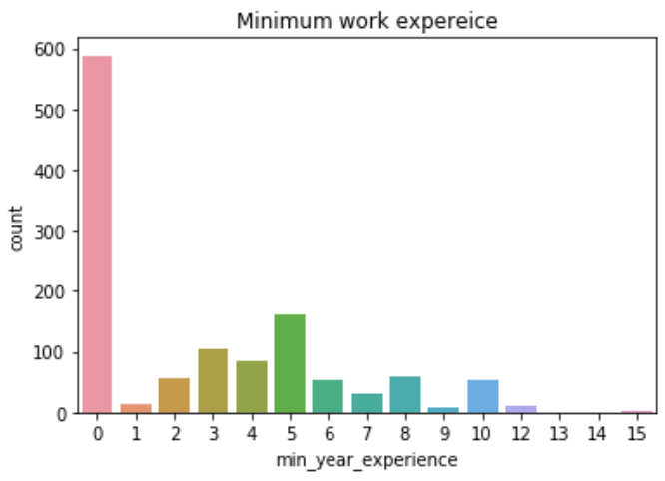
Data Visualization: Degree and Minimum Work Experience

Slide 7
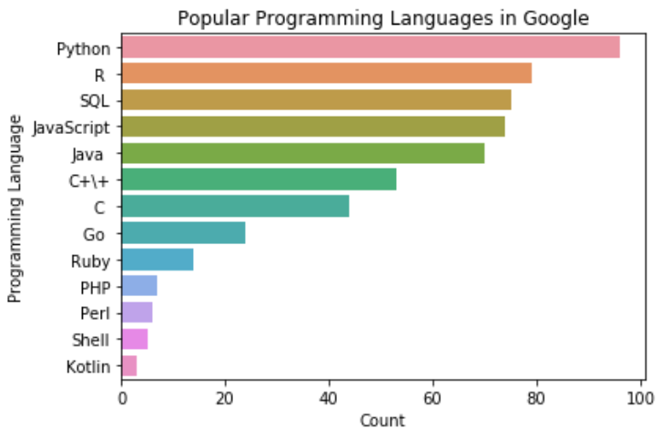
Data Visualization: Popular Programming Language in Google

Slide 8
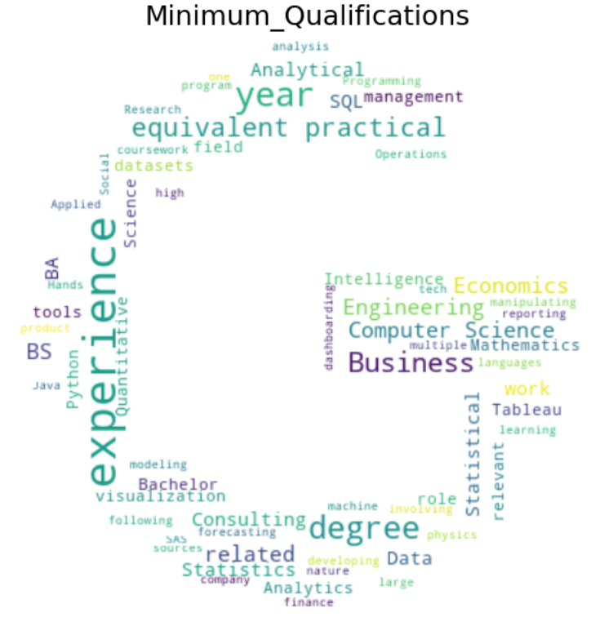
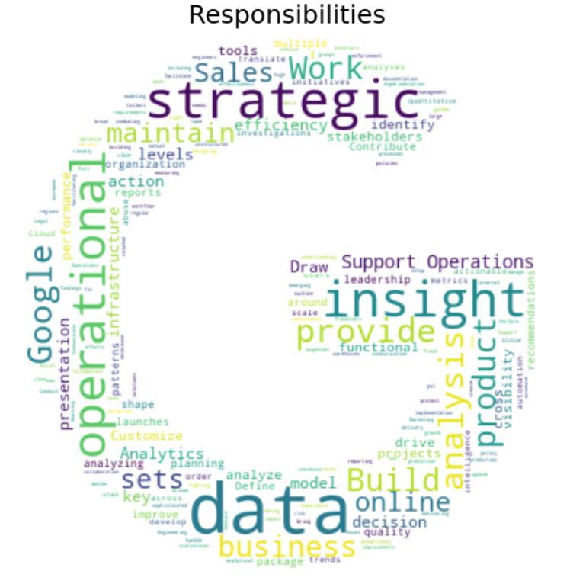
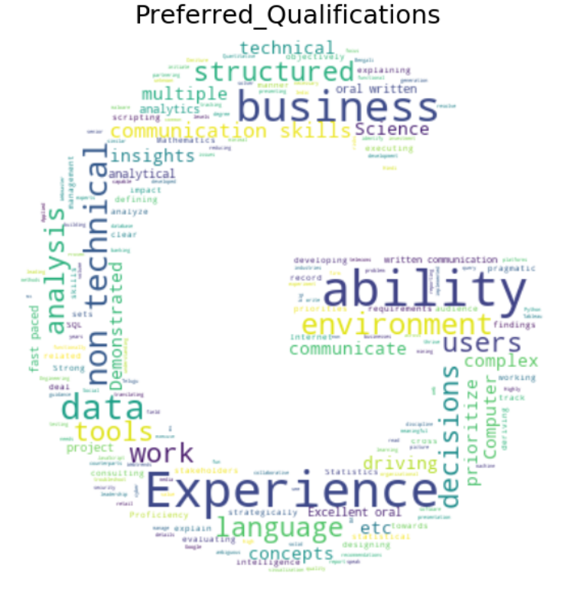
Data Analyst: Responsibilities and Qualifications

Slide 9
Machine Learning Model
Linear SVC
Decision Tree
Random Forest
SVC

Slide 10
Machine Learning Model
Classification Model Metrics
Balanced Accuracy
F1 score
Precision
recall

Slide 11
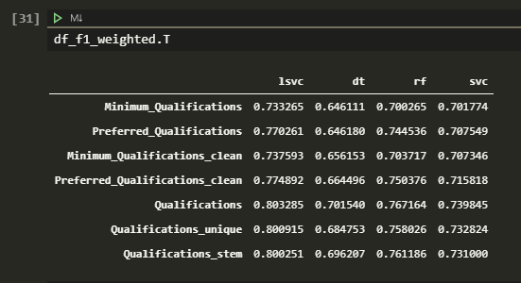
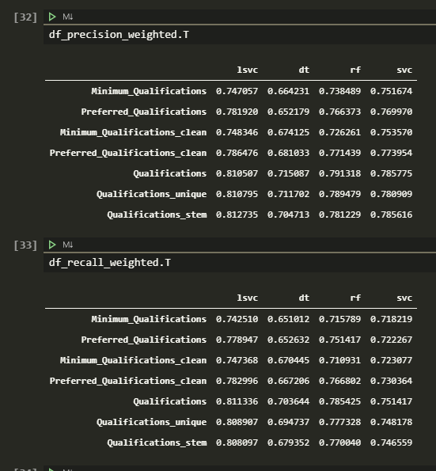
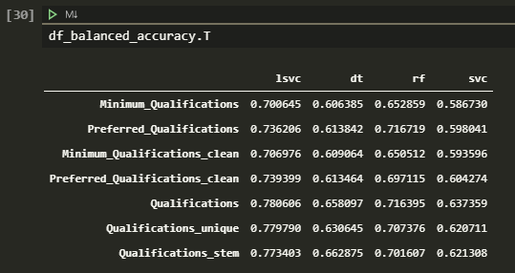
Machine Learning Model

Slide 12
Machine Learning Model
The Winner Model is Linear SVC
Balanced accuracy score: 78%
F1 Score: 80%
Precision score: 81%
Recall Score: 81%
With feature “Qualifications” column
Hyperparameter tuning not giving much improvement, but I’ll use it anyway

Slide 13
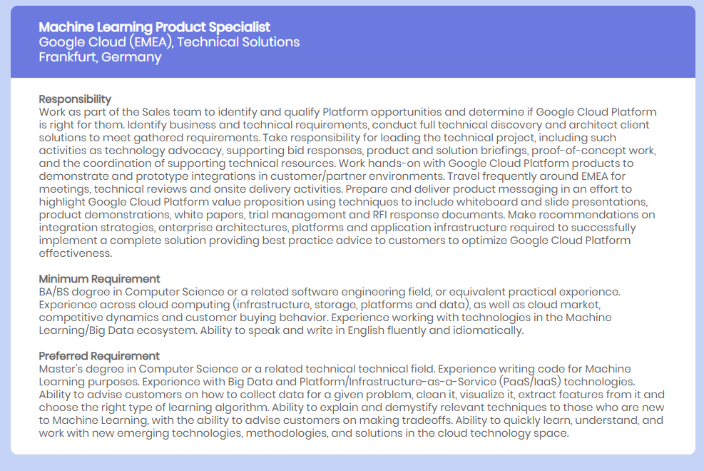
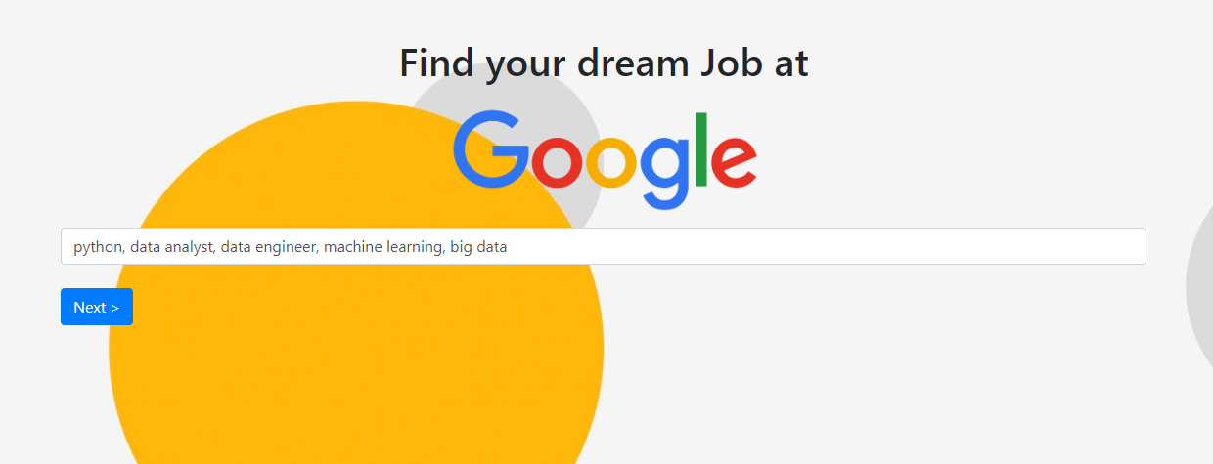
The Apps
Skills: Python, Data Analyst, Data Engineer, Machine Learning, Big Data
Recommendation:
Job Category: Technical Solutions
Job Title: Machine Learning, Product Specialist

Slide 14
Thank You
Farid Rahman | fr.farid.Rahman@gmail.com

